Slide 1
Explainable and Usable AI
CS 344 2022-04-20

Slide 2
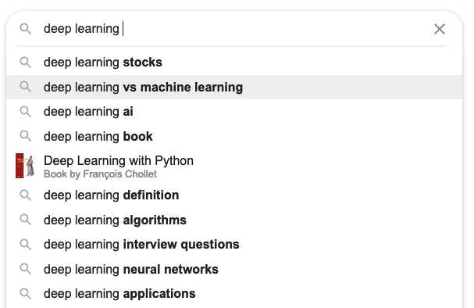
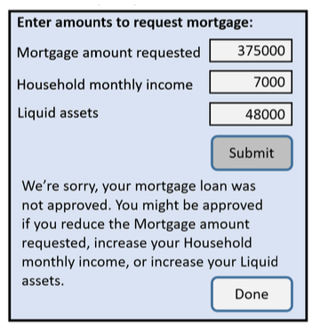

Slide 3
Logistics
Projects
Meetings
Grading
Presentations next Thursday morning
Optional Homework posted

Slide 4

Explain Your Decisions
Likely to get arrested again in next 2 years?
Positive or Negative Review?
Dog or Cat?
all the amped up tony hawk style stunts and thrashing rap-metal can't disguise the fact that, really, we've been here, done that.
The defendant is a Male aged 38. They have been charged with: Battery. This crime is classified as a Misdemeanor. They have been convicted of 0 prior crimes. They have 0 juvenile felony charges and 0 juvenile misdemeanor charges on their record.
Sources: Review: example from https://demo.allennlp.org/sentiment-analysis/roberta-sentiment-analysis. Recidivism: Random sample from Broward County, Florida records from 2013 and 2014, based on data acquisition and analysis by ProPublica, displayed as in Dressel and Farid 2018 https://www.science.org/doi/10.1126/sciadv.aao5580. Image: https://www.boredpanda.com/puppy-looks-like-cat-dog-hybrid/

Slide 5
How did you explain it?

Slide 6
Main Points
Explainable ≠ interpretable
Models don’t have to be black-box to be accurate.
“Amplify, Augment, Empower, and Enhance People” (-Shneiderman)

Slide 7
Why care?
harms when systems aren’t reliable, safe, trustworthy
benefits when systems empower people

Slide 8
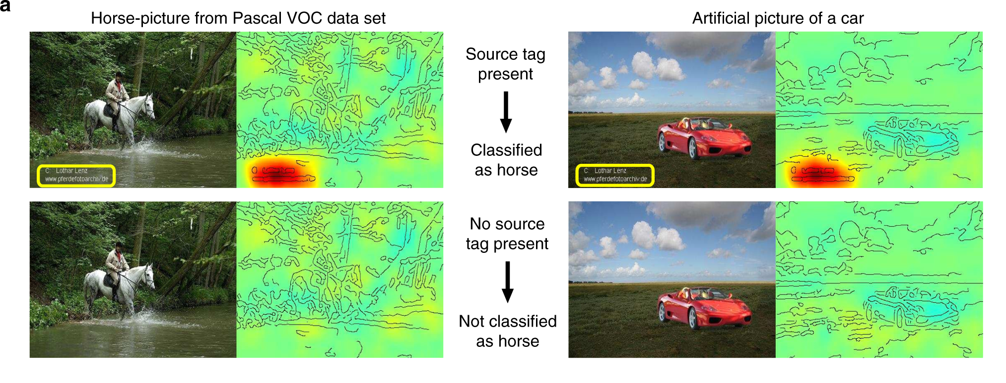
Lapuschkin et al. 2019. Unmasking Clever Hans predictors and assessing what machines really learn

Slide 9
Some Interpretable Models
All examples from Rudin et al. 2020, Interpretable Machine Learning: Fundamental Principles and 10 Grand Challenges

Slide 10
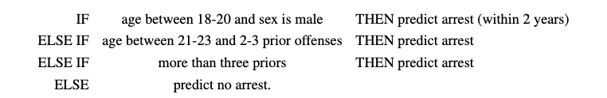
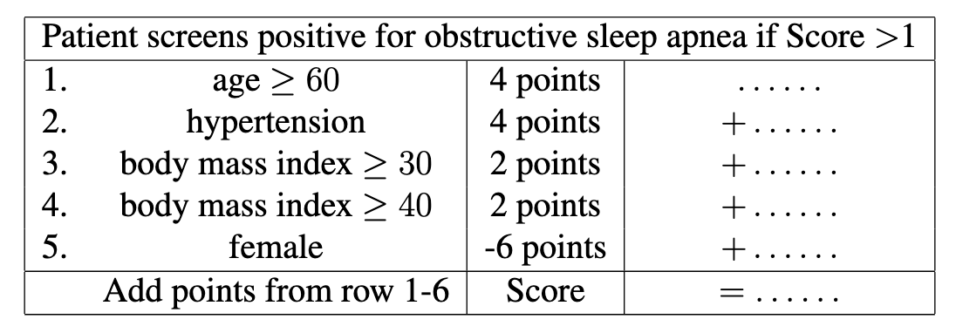
Rule lists and scoring systems
Angelino et al. 2017. Learning Certifiably Optimal Rule Lists for Categorical Data

Slide 11
Generalized Additive Models (GAM)
Score: risk of having diabetes.
plasma glucose concentration after 2 hours into an oral glucose tolerance test

Slide 12
Prototype-based, part-based

Slide 13
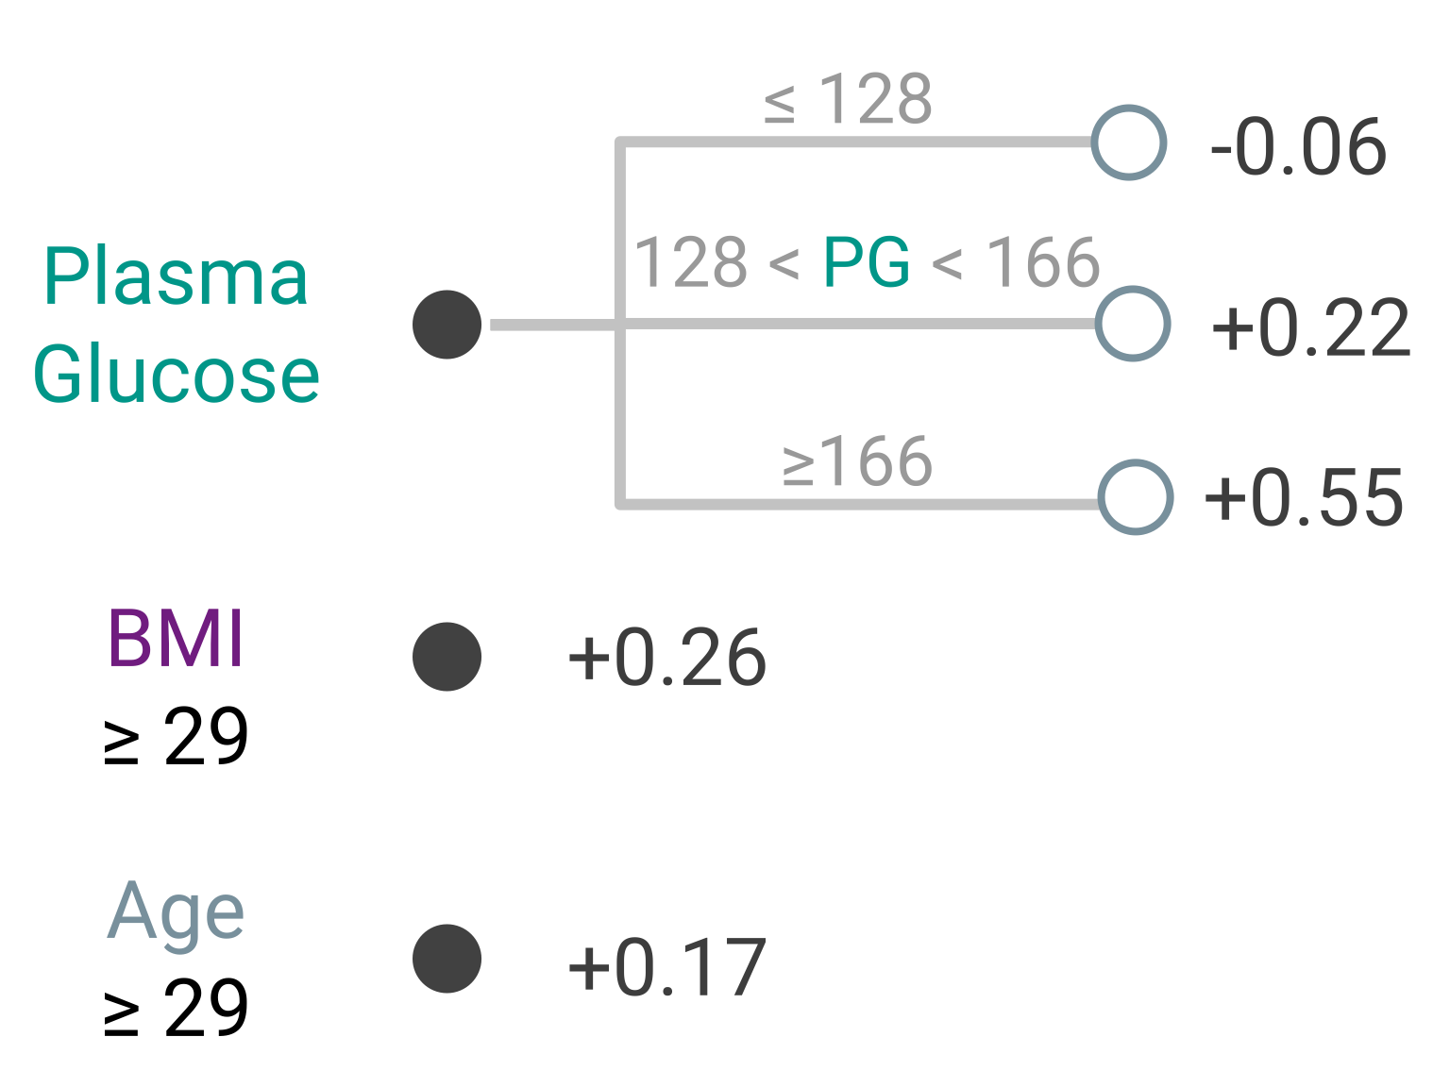
Sums of Trees
Diabetes
Fast Interpretable Greedy-Tree Sums (FIGS)
Go through each tree independently
Sum the outputs of each tree
Interpretable: each tree can be shallow.

Slide 14
What if we need a black box model?
Can we “explain” such a model?

Slide 15
Dimensionality Reduction

Slide 16
Chefer et al. 2021, Transformer Interpretability Beyond Attention Visualization

Slide 17
Other ways to interpret

Slide 18
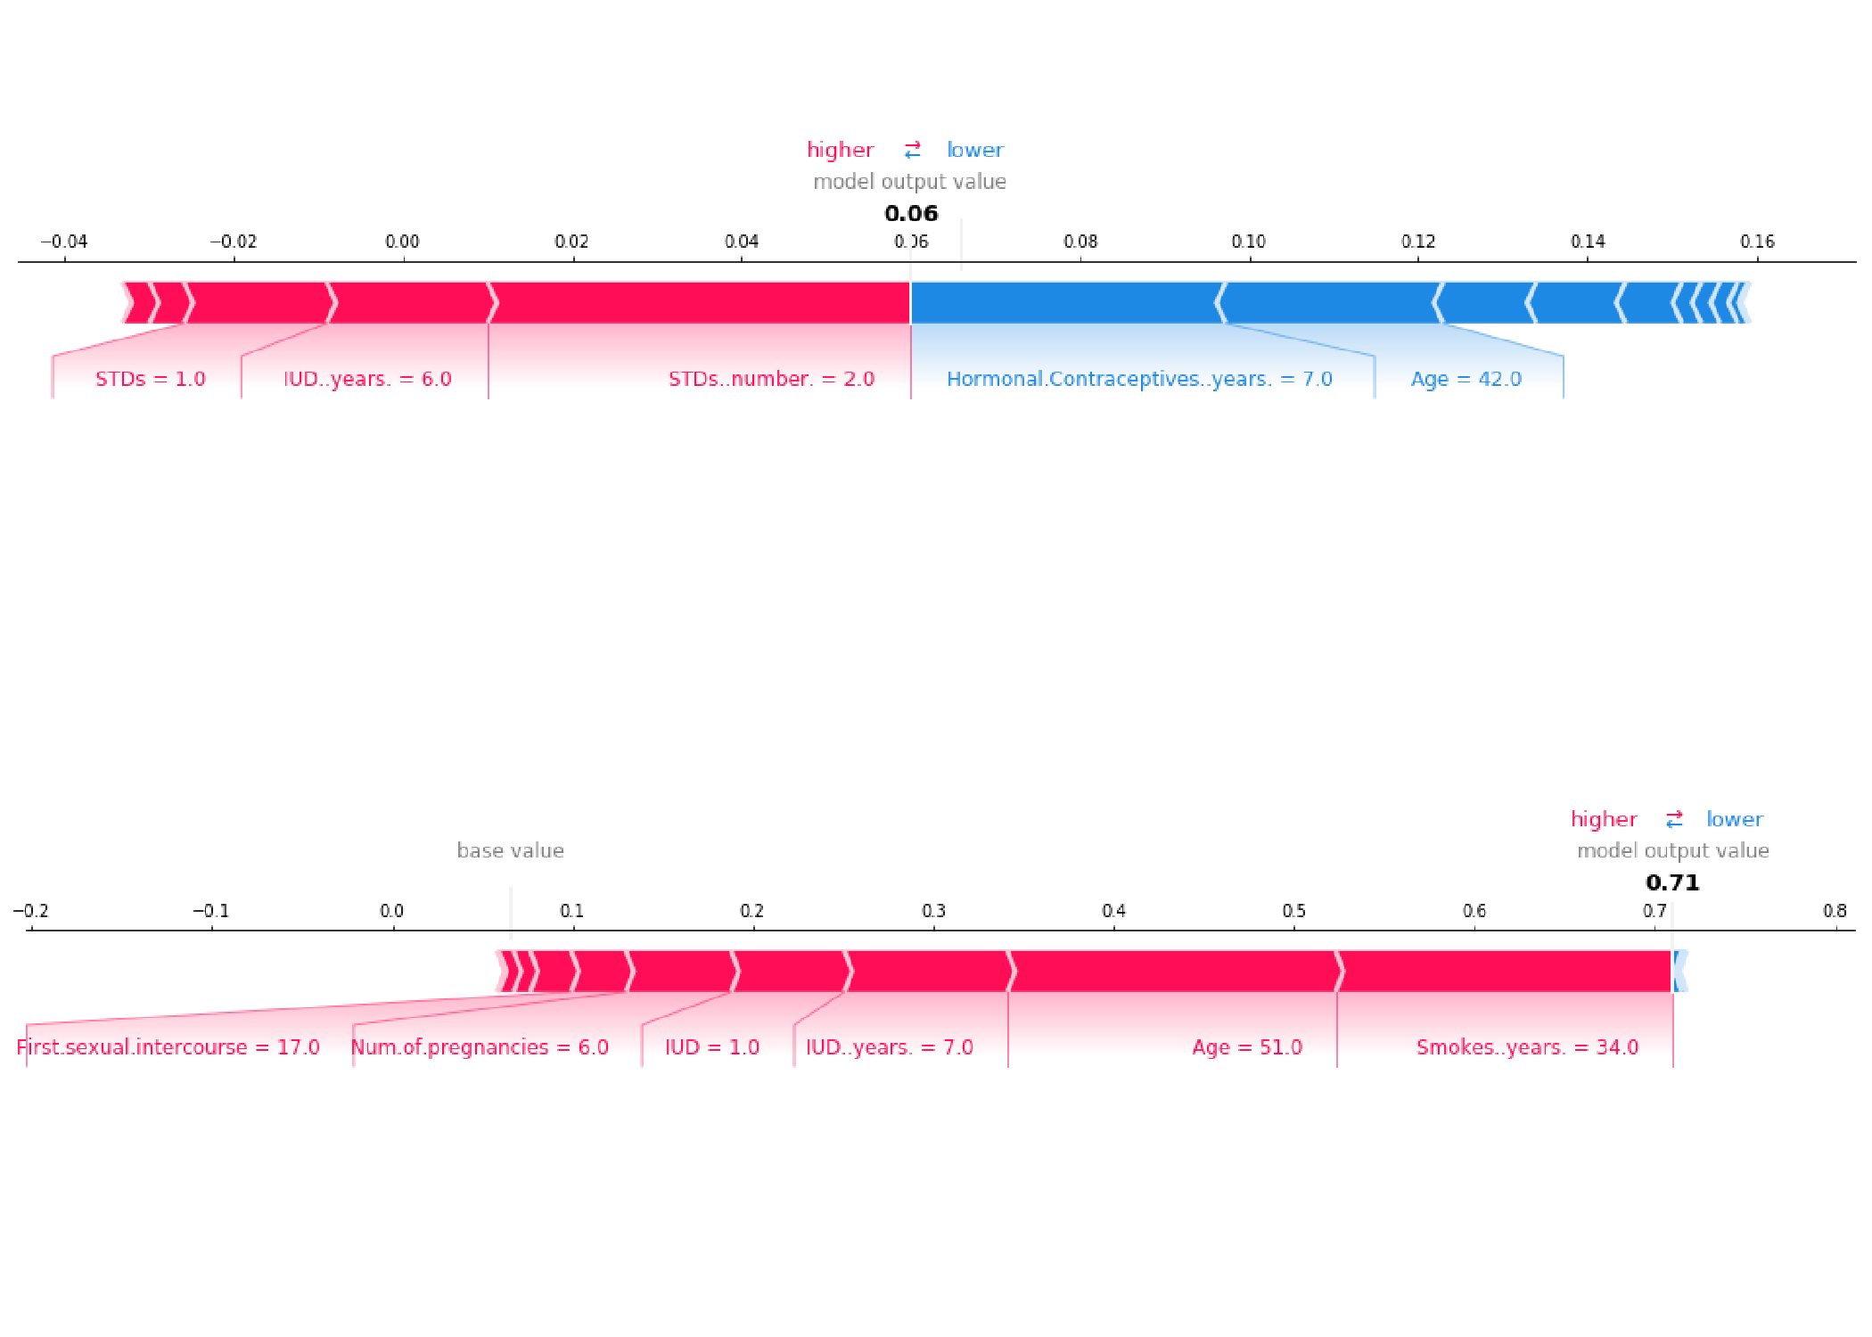
Shapley Values for Explaining Predictions Intuition: average effect of having that feature vs leaving it out
SHAP values to explain the predicted cervical cancer probabilities of two individuals
Source: https://christophm.github.io/interpretable-ml-book/shap.html

Slide 19
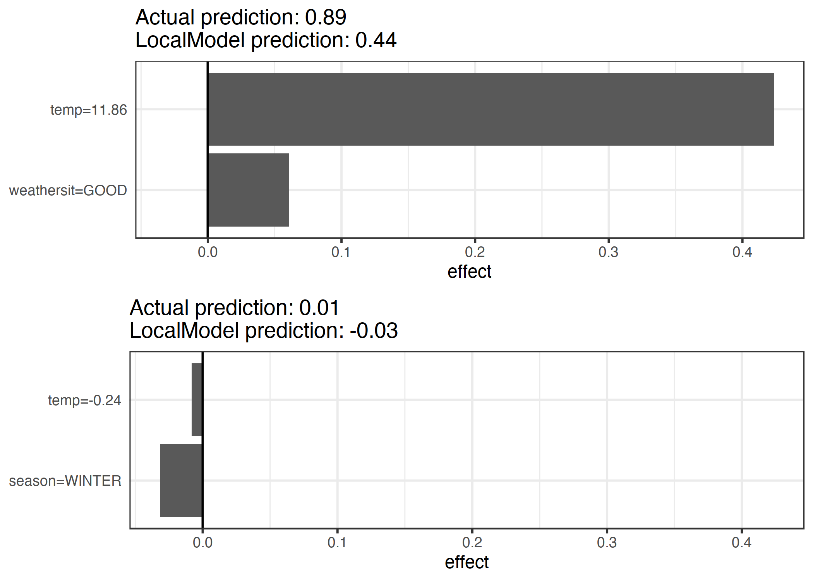
Local Interpretable Model-agnostic Explanations Intuition: fit a simple model in the “neighborhood” of an example
Example: predict if a day will have more or fewer bike rentals than average
Main model: random forest
Surrogate model: logistic reg, 2 features
https://christophm.github.io/interpretable-ml-book/lime.html

Slide 20
Explainable vs Interpretable
Explainable: why did the black box model gave us this answer?
Interpretable: the model isn't a black box

Slide 21
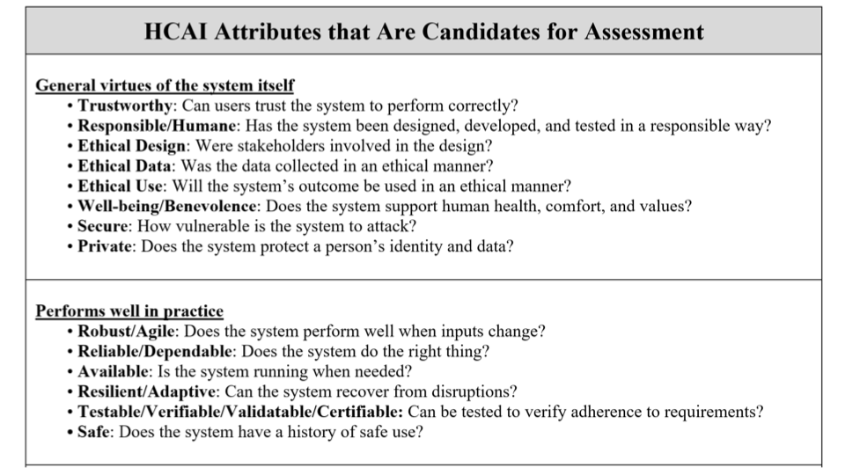
Ben Shneiderman – HCAI Tutorial at ACM IUI 2021 - https://iui.acm.org/2021/hcai_tutorial.html

Slide 22
